Slide 1
Database of the center for people with special needs
Sama Khaled
Atheel hamayel

Slide 2
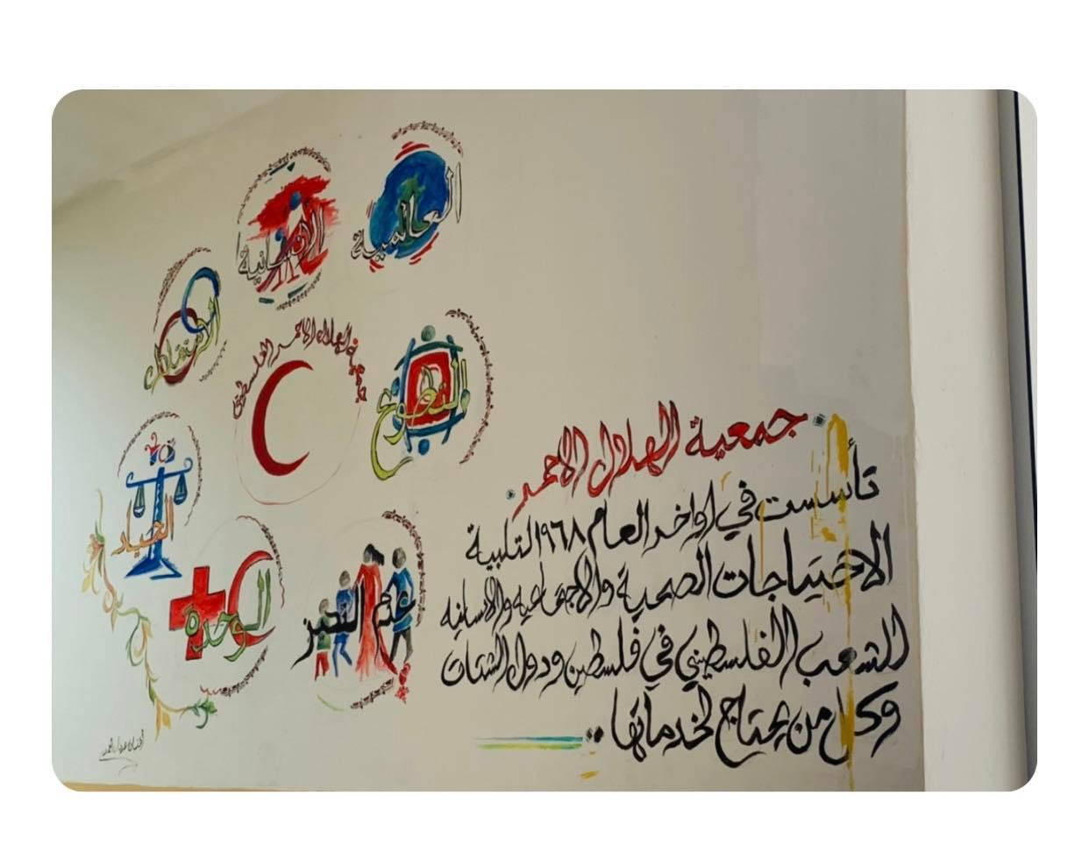

Slide 3
About the center:
There is a group of employees in the center.
Each employee works in a specific section , and in the section there are a number of rooms, and for each section there is a specific manager.
In each section, a number of people with special needs are registered.
Certain information about the child's family is recorded.

Slide 4
The main entities
Employees
Sections
Rooms
People with special needs
Family

Slide 5
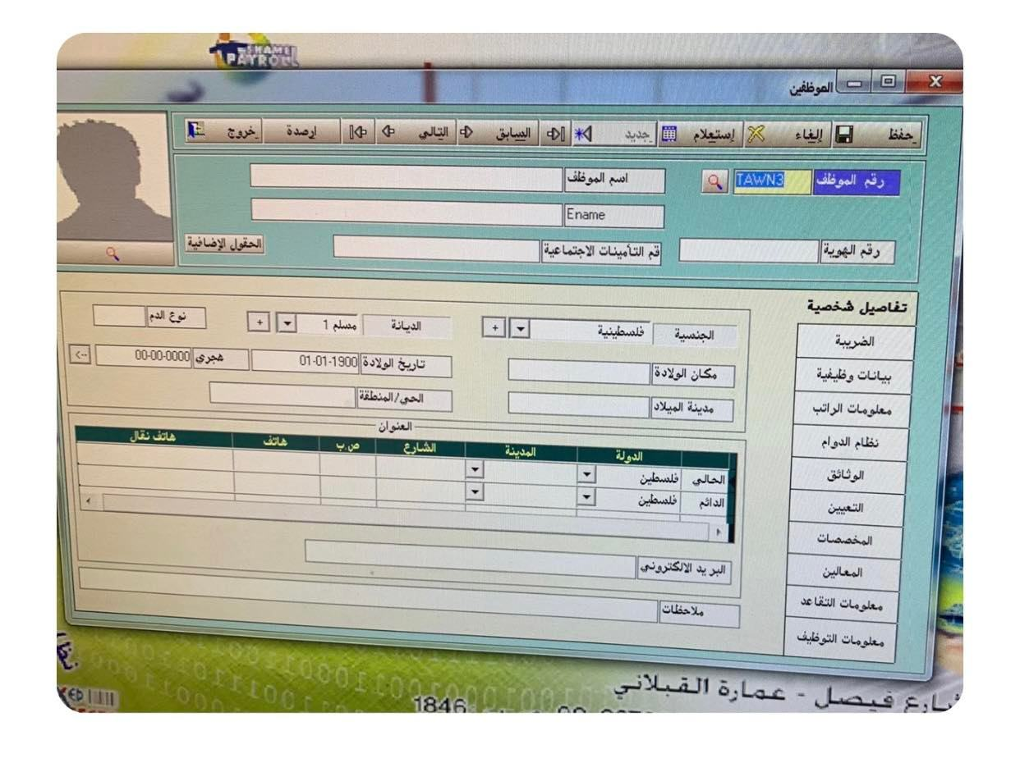
The main entities (cont.) :
Employees :

Slide 6
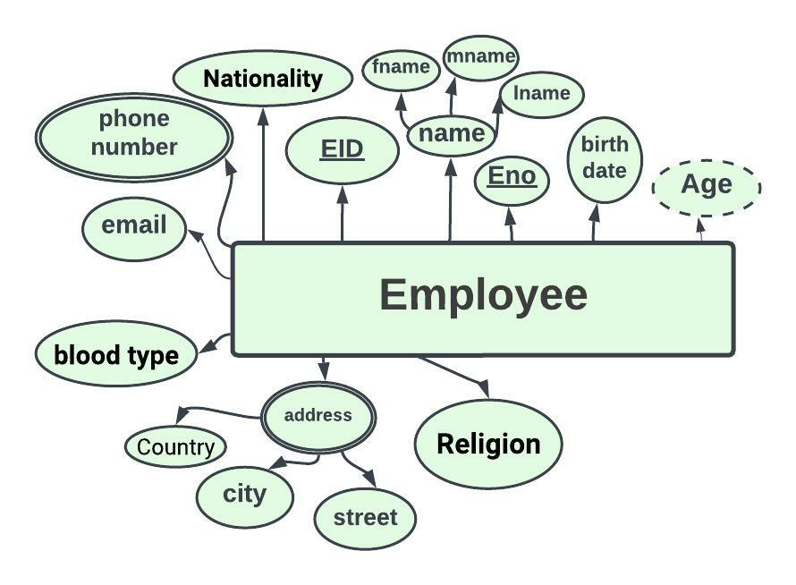

Slide 7
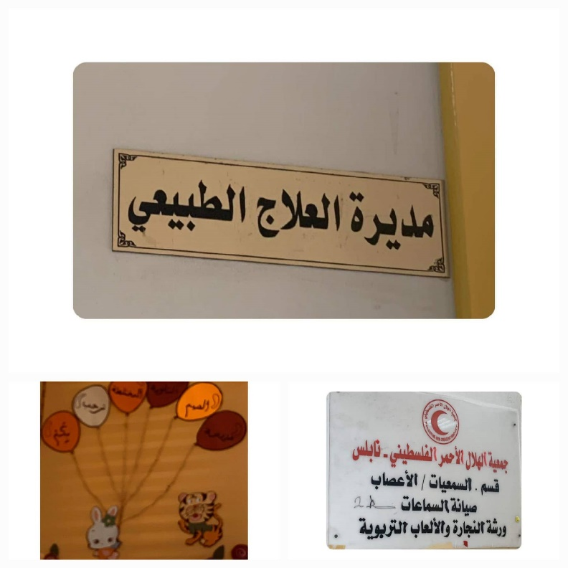
The main entities (cont.) :
Sections :

Slide 8
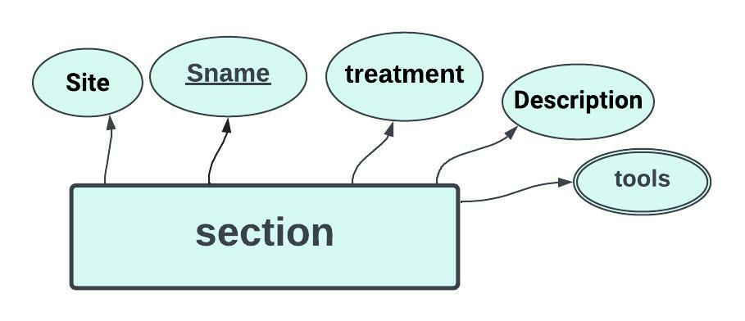

Slide 9
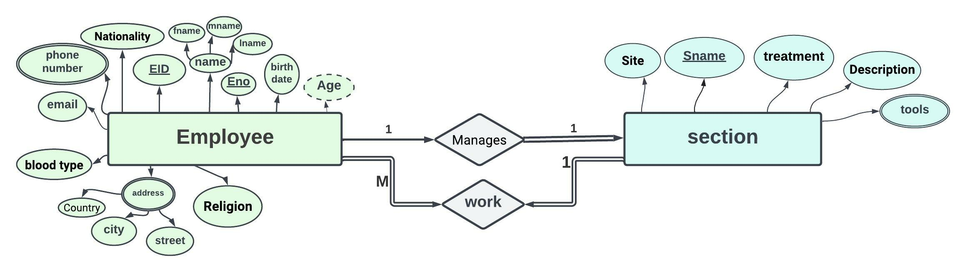

Slide 10
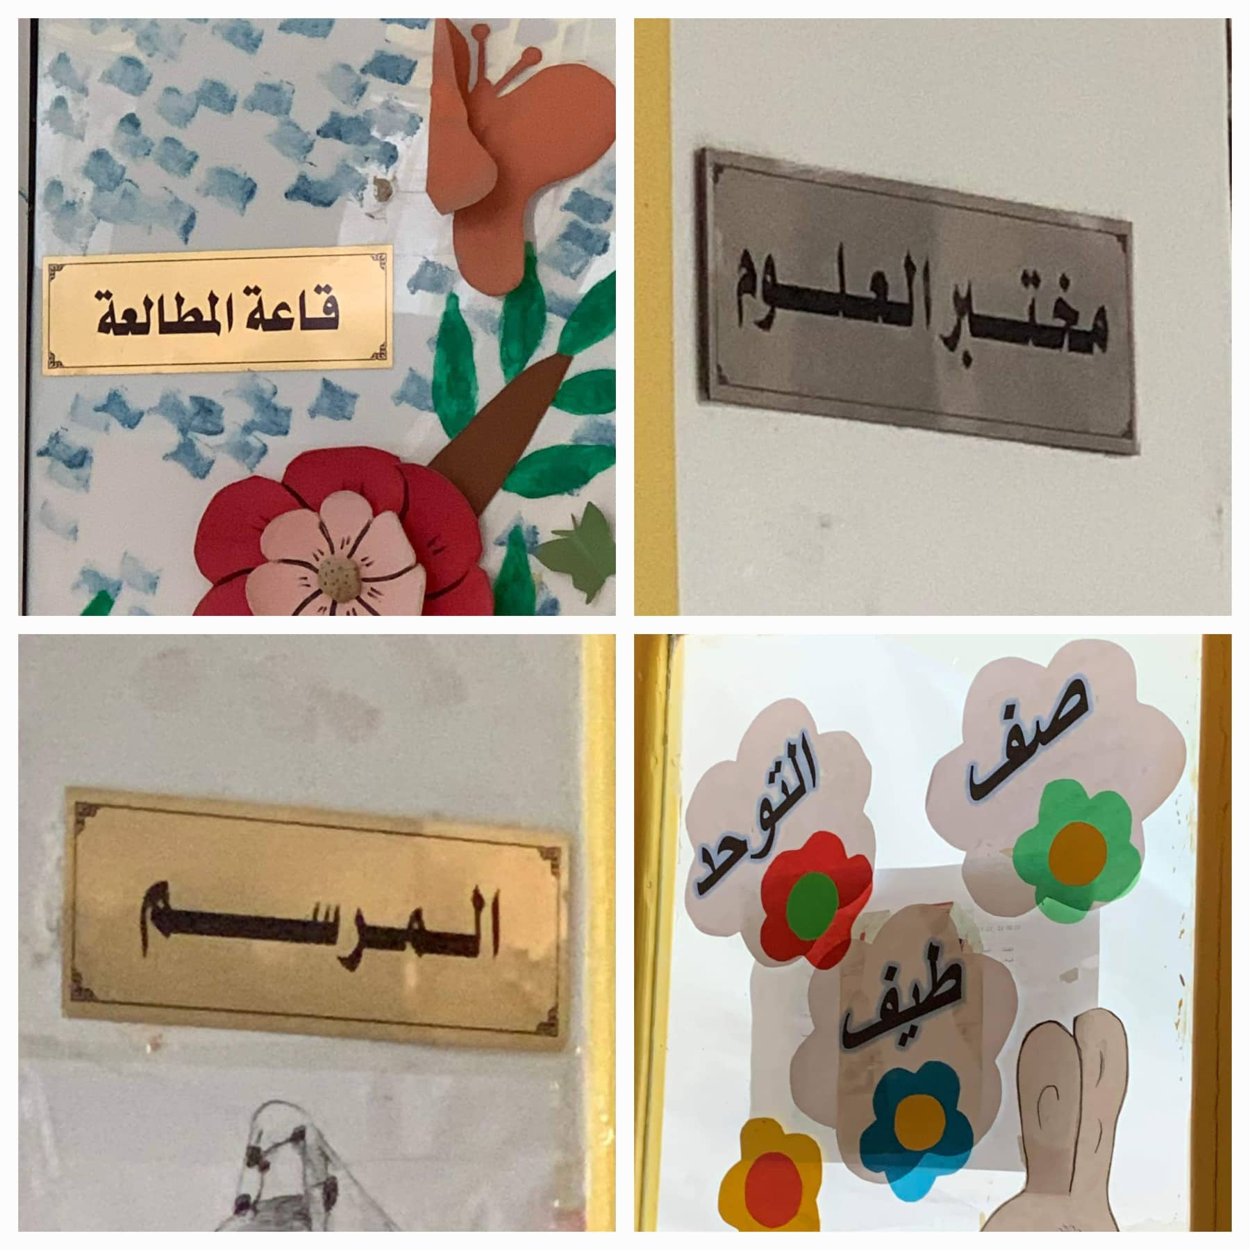
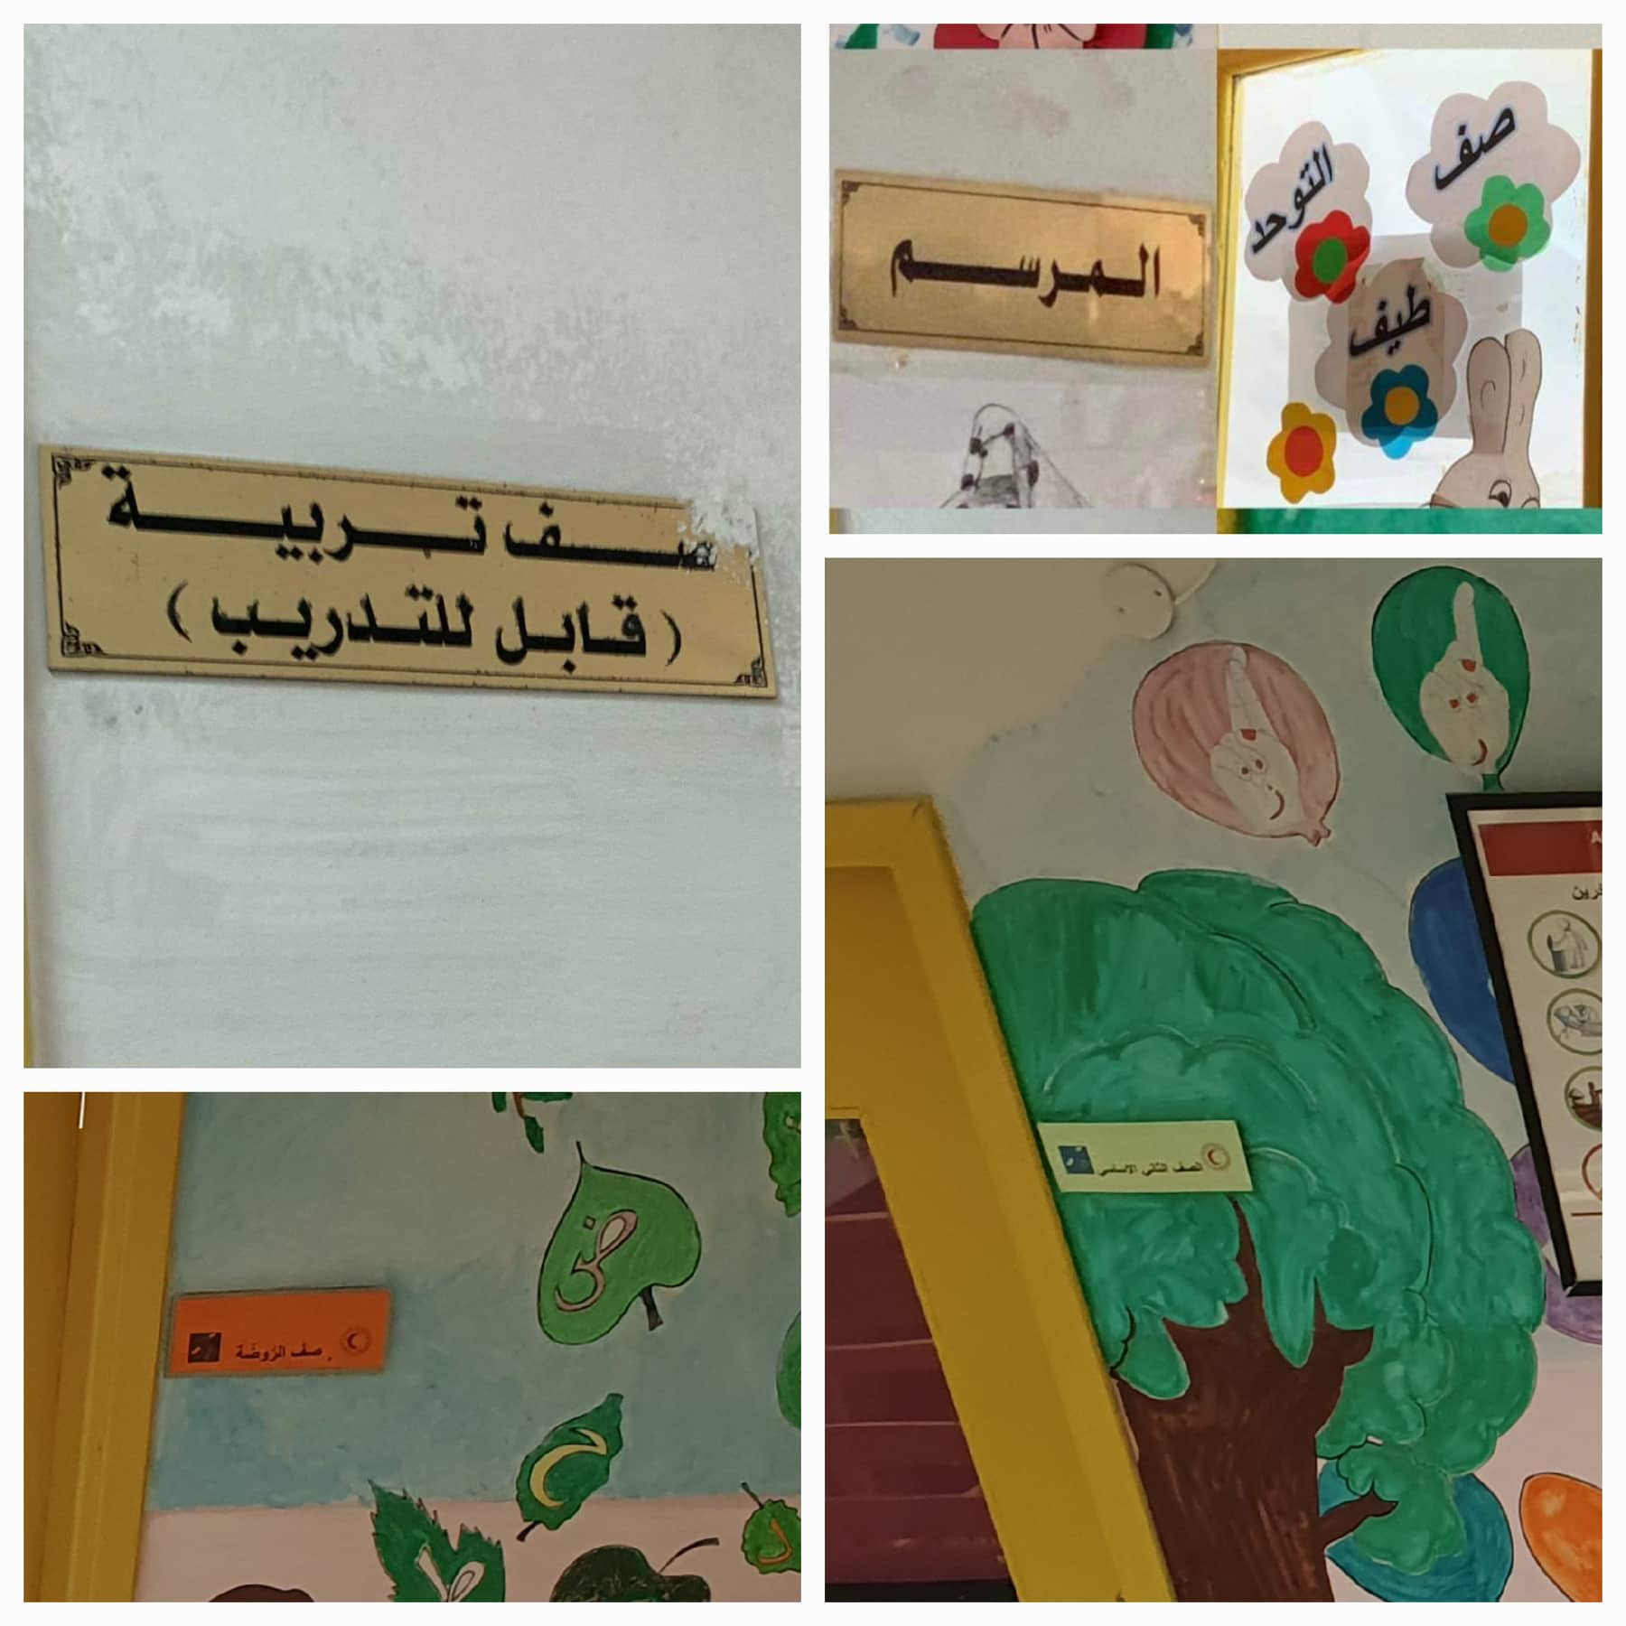
The main entities (cont.) :
Rooms :

Slide 11
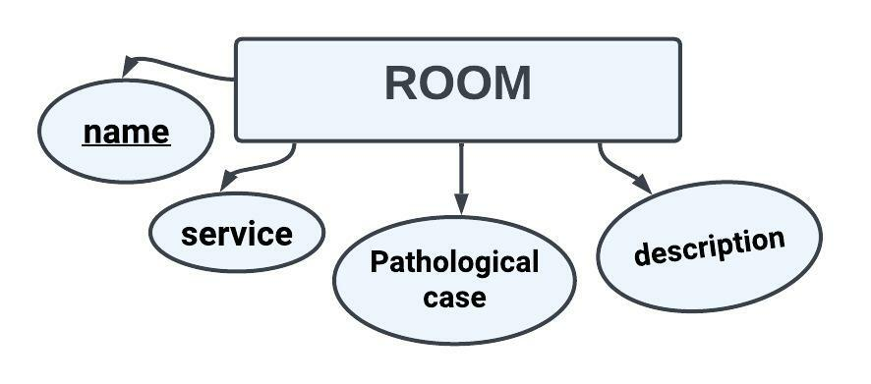

Slide 12
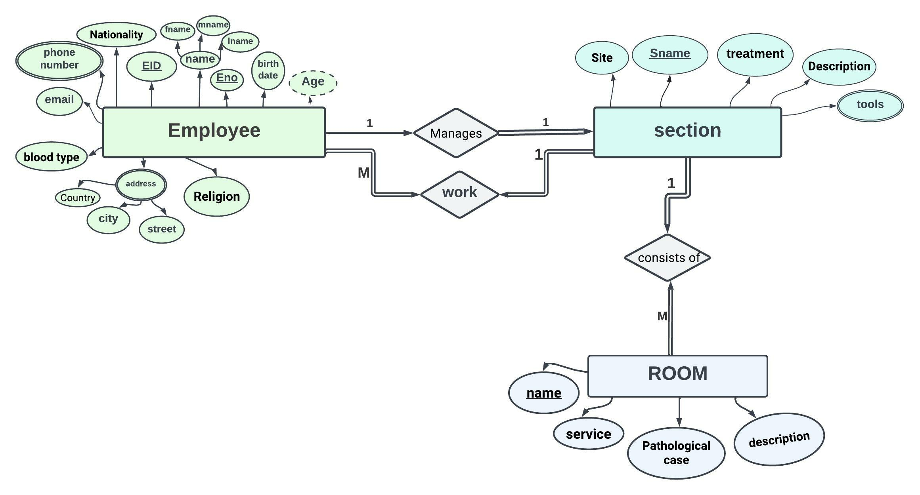

Slide 13
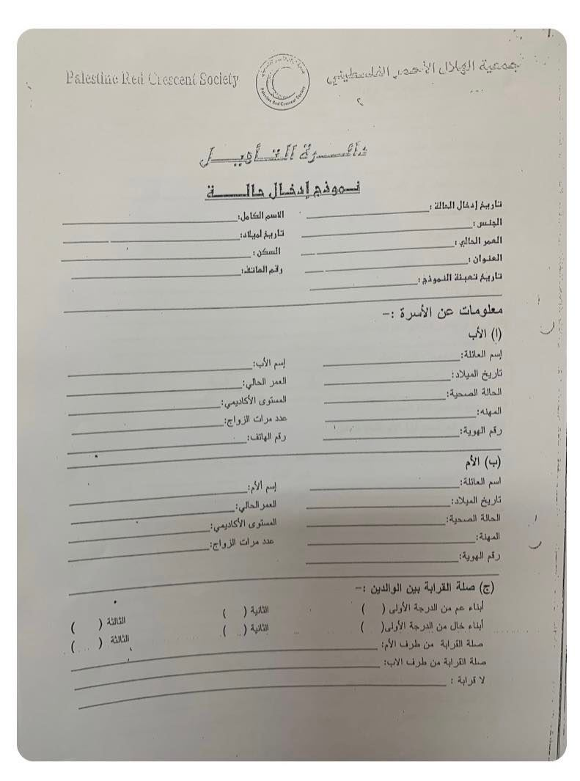
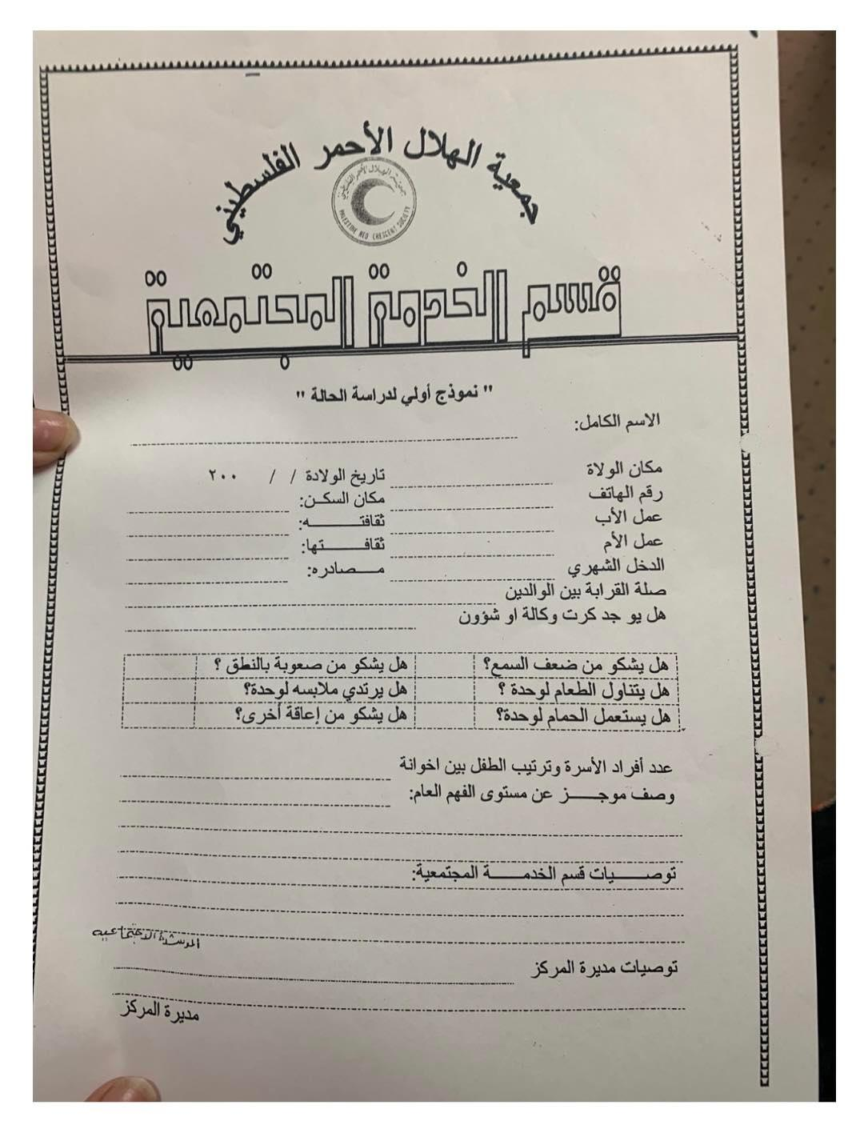
The main entities (cont.) :
People with special needs :

Slide 14
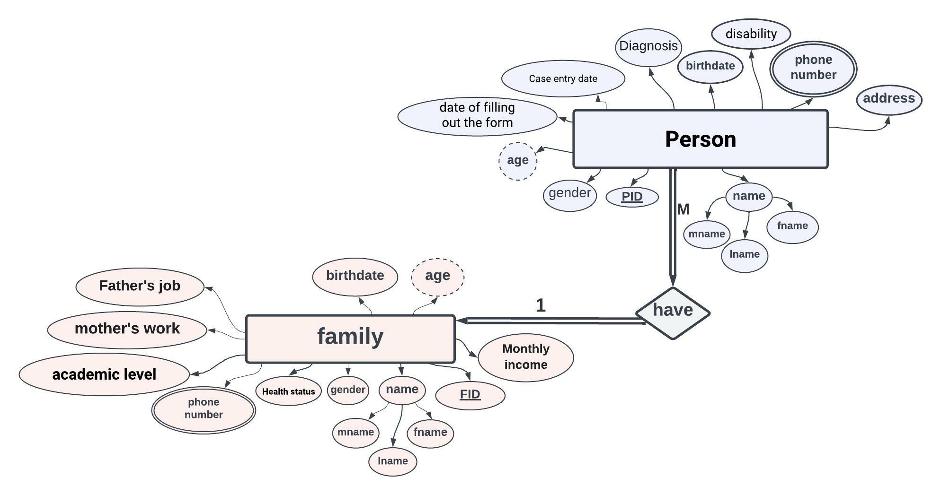

Slide 15
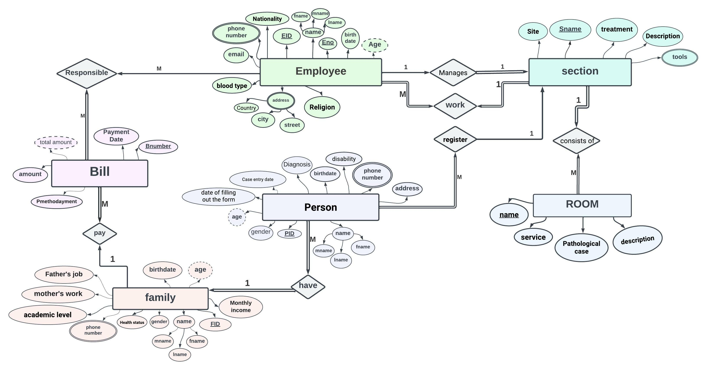
بعد التعديل :

Slide 16
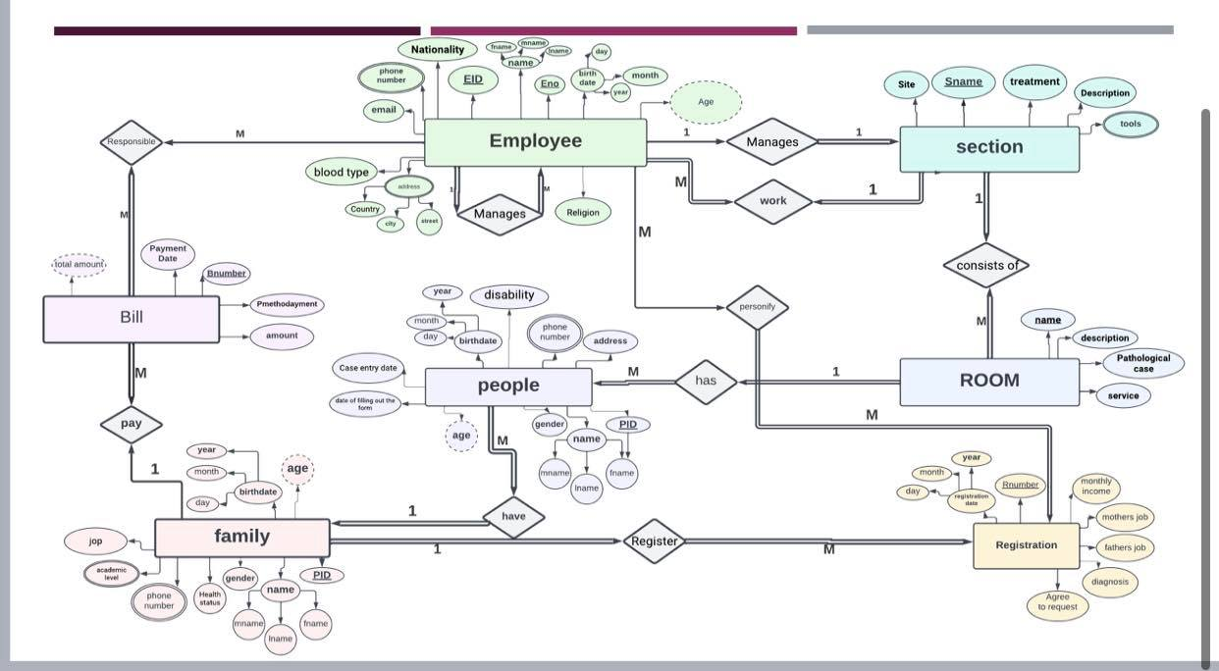
ER قبل التعديل

